Slide 1
Case Study: Information Strategy
Business Intelligence & Analytics

Slide 2
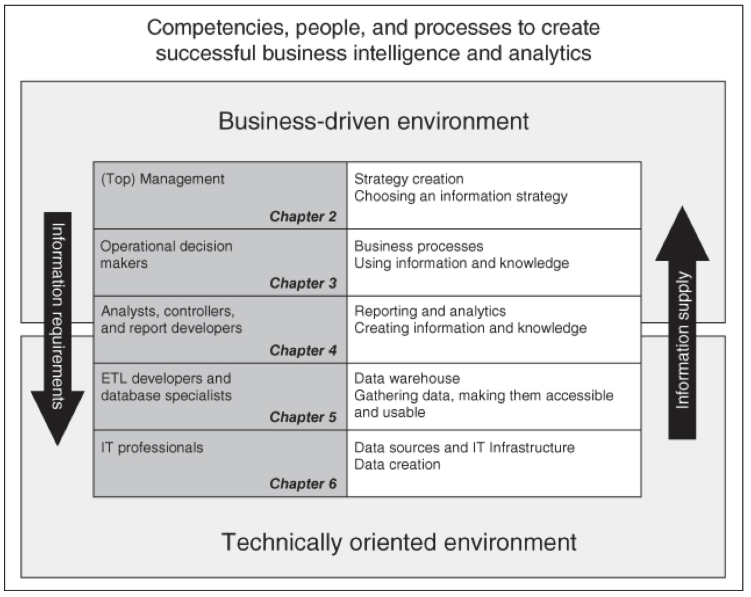

Slide 3
radio
Station sends signal over the air
User has to turn the dial to the desired “station”
User then listens to whatever happens to be on at the time
Radio relies on advertising to fund the business

Slide 4
audience
Notes:
Here I want the images to show up one at a time in the order specified and end a few seconds before I move on.

Slide 5
Radio station strategy
Company Profile:
Nationwide Radio Station
Vision: there is demand for radio entertainment in the shape of good music, entertaining talk and news
Mission: to become a leading player in the national market
Goals
Market share >= 25%
Return on Equity >= 15%

Slide 6
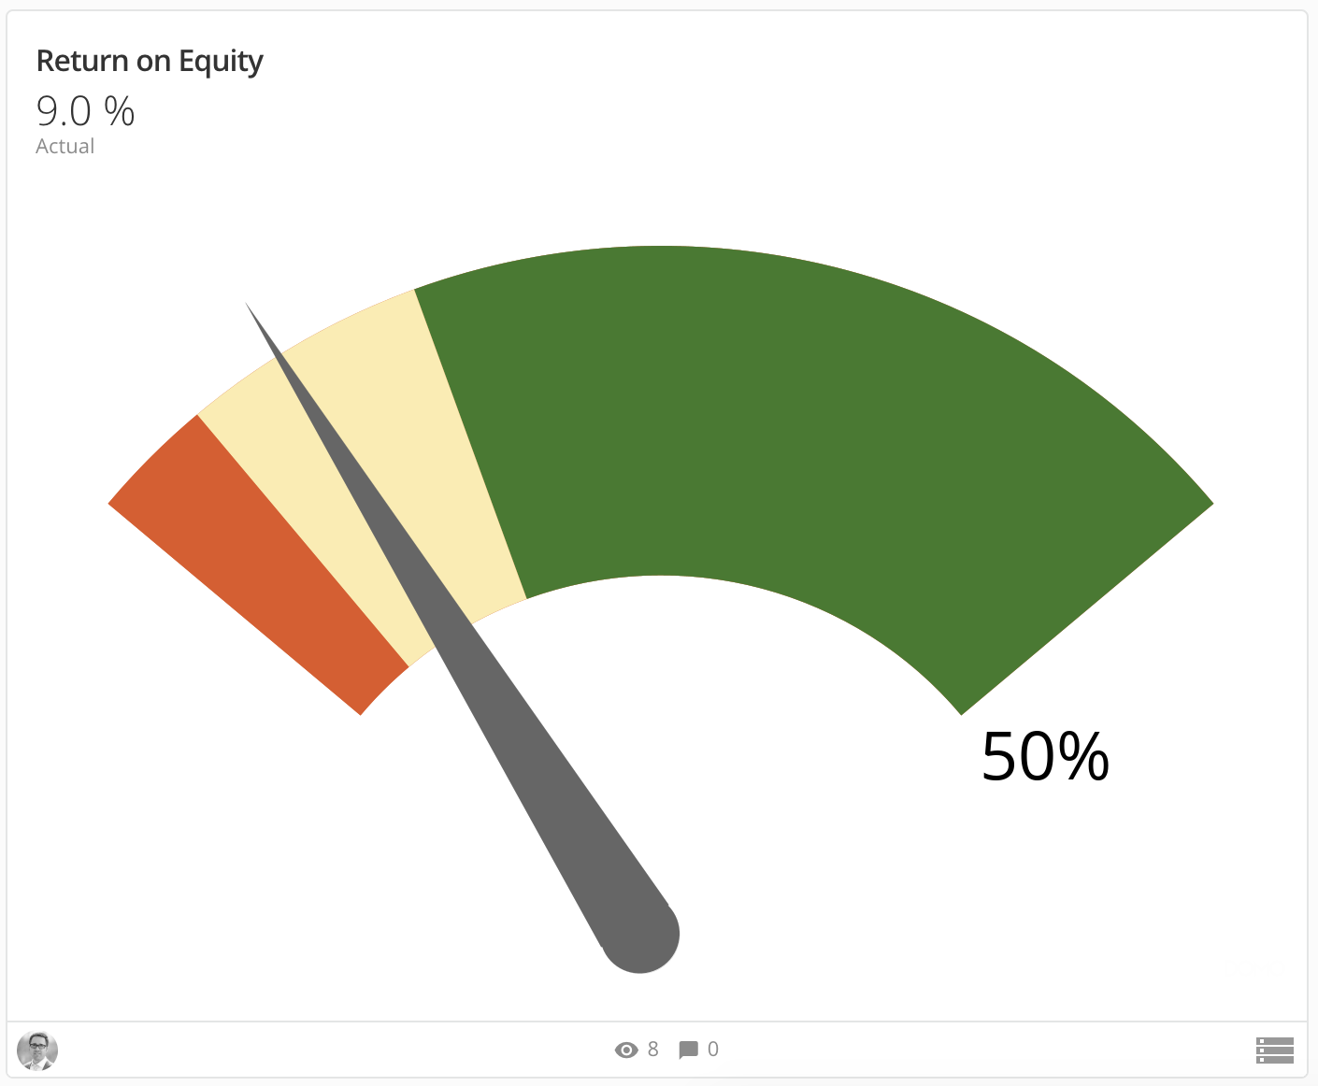
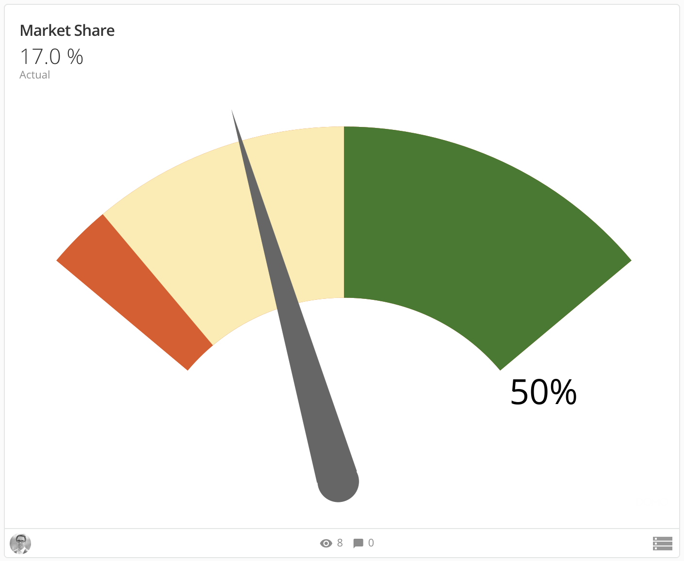
Executive dashboard
The more important metric
Affected by the market share
Percentage of the market listening
Assumed that if market share is high, ROE will be larger for a given level of cost

Slide 7
New strategic initiative
15 minutes
30 minutes
Increase average listening time
Should increase market share
Increase advertising revenue
Which would increase return on equity

Slide 8
Business case
Business outcome | Value
Listener time | 30 minutes
Market Share | At least 25%
Advertising revenue | $4M (additional)
Return on Equity | 13%
Cost | Value
Three employees in 4 months | $750,000
Software Purchase + Consulting | $250,000
Total | $1,000,000
Payback time = 1 Quarter
Cost = $1M
Benefit = $4M

Slide 9
BA Model Check-in
Business Analytics Model | Status
Strategy creation Choosing an information strategy | 😎
Business processes Using information and knowledge
Reporting and analytics Creating information and knowledge
Data warehouse Gathering data
Data sources and IT infrastructure Data creation

Slide 10
How does the station operate?

Slide 11
BA Model Check-in
Business Analytics Model | Status
Strategy creation Choosing an information strategy | 😎
Business processes Using information and knowledge | 🤔
Reporting and analytics Creating information and knowledge
Data warehouse Gathering data
Data sources and IT infrastructure Data creation

Slide 12
Analytics department
Questions asked:
Who are our listeners?
What do they like to listen to?
Who listens to what and when?
No
Do we have the data?
Context provided:
What is the business initiative?
How are processes going to change as a result?

Slide 13
BA Model Check-in
Business Analytics Model | Status
Strategy creation Choosing an information strategy | 😎
Business processes Using information and knowledge | 🤔
Reporting and analytics Creating information and knowledge | 😖
Data warehouse Gathering data
Data sources and IT infrastructure Data creation

Slide 14
Data warehouse?
The data isn’t here either…

Slide 15
BA Model Check-in
Business Analytics Model | Status
Strategy creation Choosing an information strategy | 😎
Business processes Using information and knowledge | 🤔
Reporting and analytics Creating information and knowledge | 😖
Data warehouse Gathering data | 🐀🐀
Data sources and IT infrastructure Data creation

Slide 16
It ops and development
Use survey tool to collect data like:
Age
Gender
Music taste
Mood
Listening time
Merge questionnaire results

Slide 17
BA Model Check-in
Business Analytics Model | Status
Strategy creation Choosing an information strategy | 😎
Business processes Using information and knowledge | 🤔
Reporting and analytics Creating information and knowledge | 😖
Data warehouse Gathering data | 🐀🐀
Data sources and IT infrastructure Data creation | 😎

Slide 18
BA Model Check-in
Business Analytics Model | Status
Strategy creation Choosing an information strategy | 😎
Business processes Using information and knowledge | 🤔
Reporting and analytics Creating information and knowledge | 😖
Data warehouse Gathering data | 😎
Data sources and IT infrastructure Data creation | 😎

Slide 19
BA Model Check-in
Business Analytics Model | Status
Strategy creation Choosing an information strategy | 😎
Business processes Using information and knowledge | 🤔
Reporting and analytics Creating information and knowledge | 😎
Data warehouse Gathering data | 😎
Data sources and IT infrastructure Data creation | 😎

Slide 20
BA Model Check-in
Business Analytics Model | Status
Strategy creation Choosing an information strategy | 😎
Business processes Using information and knowledge | 😎
Reporting and analytics Creating information and knowledge | 😎
Data warehouse Gathering data | 😎
Data sources and IT infrastructure Data creation | 😎

Slide 21
Based on the analytics delivered to the business, this radio station is able to:
Understand listeners preferences
Hold listeners attention for an average of 30 minutes
Increases market share
Increases advertising revenue
Increases return on equity
Also serves as a good case study in the ideal way analytics functions.

Slide 22


